Slide 1
Confidence-Based Model Fusion (CBMF) for Robust Adversarial Poisoning Detection in SDN
MEMBERS:
SHINMAYA K.B 9517202306091
SHREE HARINI K 9517202306092
VARSHA G.A 95172023060111
MENTOR:Mr.M.V.Balaganesh BTech, MTech
Assistant Professor

Slide 2
INTRODUCTION
Overview:
Network intrusion detection systems (NIDS) in software-defined networks (SDNs) are vulnerable to adversarial poisoning attacks, like Random Label Manipulation (RLM).
TAPD (Trans-controller Adversarial Perturbation Detection) is a new framework to detect RLM attacks in multi-controller SDNs.
TAPD can efficiently detect RLM attacks and pinpoint compromised controllers, even with a significant number of infected agents in the network.

Slide 3
LITEARTURE SURVEY
literature survey_final.pdf

Slide 4
PROBLEM DEFINITON/STAEMENT
  This paper talks about a problem where ML-based network intrusion detection systems (called NIDS) in multi-controller software-defined networks (MSDNs) are vulnerable to a type of attack called Random Label Manipulation (RLM). In this attack, bad actors can change or flip the labels in the training data, causing the ML system to make incorrect decisions about what is normal and what is dangerous. This tricks the NIDS into missing real threats or flagging harmless traffic as threats. Since SDNs are important for modern networks, it’s crucial to find ways to detect these attacks. The main challenge is to create a simple, reliable, and scalable method that can spot when these label-flipping attacks happen and keep the network secure.

Slide 5
Challenges with Traditional Models:
  Easy to Fool: Attackers can change the labels in the training data (for example, marking some harmful traffic as benign).When the system learns from this false information, it thinks those harmful activities are okay — so it doesn’t notice or stop the attacks.
  Lack of Coordination: In traditional setups, each network controller works independently without sharing information. This means if an attacker compromises one controller, others might not notice, making it easier for the attacker to hide their malicious actions across the network.
  Resource Limits: Training and updating the machine learning (ML) models takes a lot of computer power and time. Because there are limited resources, it’s hard to quickly update the models whenever new threats appear. During this delay, the network can be vulnerable and unprotected against new or changing attacks.
  Detection Gaps: Traditional detection methods may not catch new or smart attack tricks because they weren't designed for such clever strategies. So, some attacks can go unnoticed, especially those that try to hide or confuse the system on purpose.

Slide 6
SOFTWARE REQUIREMENT SPECIFICATION(SRS)

Slide 7
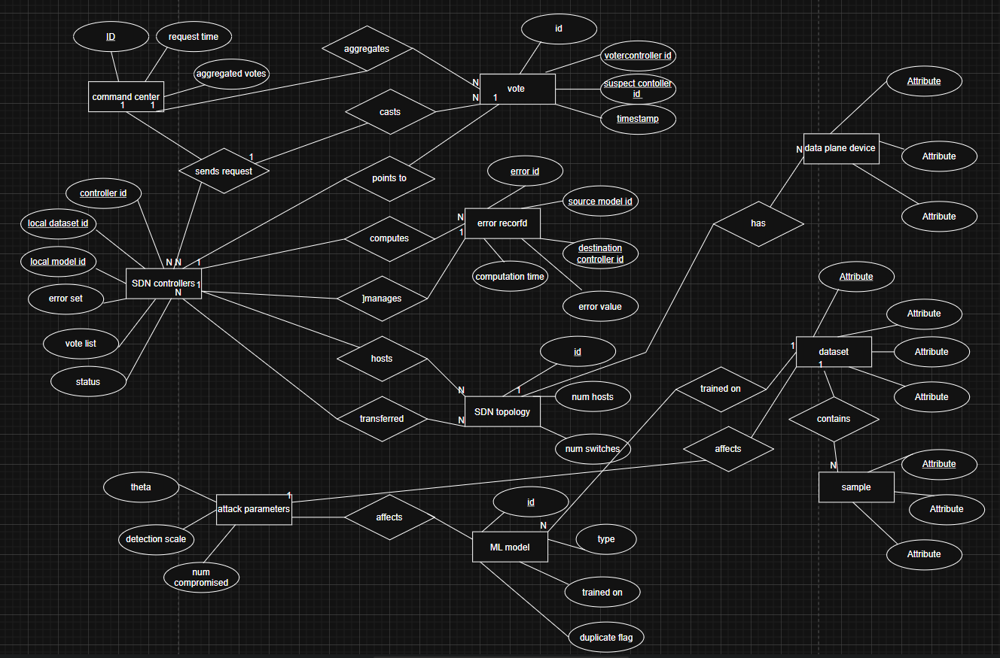
ER DIAGRAM

Slide 8
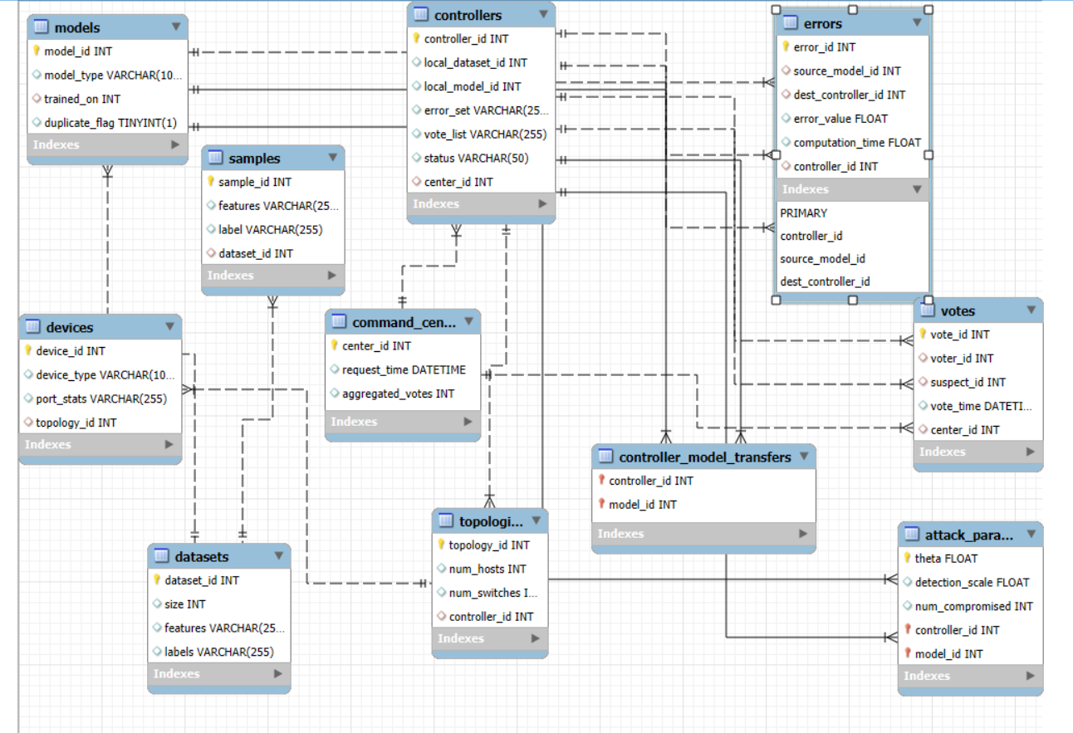
SCHEMA DIAGRAM

Slide 9
PROPOSED SYSTEM ARCHITECTURE:
Send Request
Command Center → Controllers
ML Model Transfer
Controllers Exchange Models
MAD Pre-Analysis
Estimate Compromise Level
Adaptive Detection
IQR or MAD Method
Enhanced Voting
Confidence-Weighted
Final Detection
Multi-Criteria Decision

Slide 10
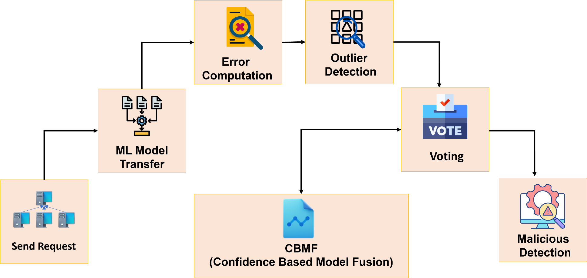

Slide 11
DESCRIPTION
MAD Pre-Analysis: Initial screening layer that estimates compromise level of incoming model updates using lightweight statistical analysis
Adaptive Detection: Implements IQR (Interquartile Range) or MAD (Median Absolute Deviation) methods to identify outlier models that deviate from normal patterns
Key Benefits:
Robust statistical outlier detection even when majority of updates are normal
Adaptive approach can switch between detection methods based on threat landscape
Acts as additional security filter before model aggregation

Slide 12
Planned DOS Attack Testing:
Volume-based DOS: Flood system with numerous malicious model updates to test detection capacity
Computational DOS: Deploy resource-intensive malicious models to test system stability
Memory Exhaustion: Large model updates designed to overwhelm system resources
Expected MAD System Response:
Quick identification and filtering of anomalous updates before core processing
Maintain federated learning functionality under attack conditions
Prevent malicious models from affecting final global model quality

Slide 13
Algorithm used:
Random Forest is an ensemble machine learning algorithm commonly used for classification and regression tasks. It builds multiple decision trees during training and combines their outputs to produce a final prediction, which improves accuracy and reduces overfitting.
How Random Forest Works:
Bootstrapping (Sampling): Multiple subsets of the training data are created by sampling with replacement.
Building Decision Trees: For each subset, a decision tree is trained. When splitting nodes, only a random subset of features is considered, adding diversity to the trees.
Aggregation: For classification tasks, each tree votes for a class label, and the majority vote becomes the final prediction. For regression, the average of all tree outputs is used.
In this paper, RF is used because of its effectiveness, robustness, and widespread acceptance in SDN security research, making it suitable for detecting malicious activities in network data

Slide 14
DATASET FOR THIS PROJECT
University of Nevada - Reno Intrusion Detection Dataset (UNR-IDD)
Description: The data includes various metrics related to network ports, packets, and bytes, along with timestamps and error counts.
It also contains information about connection points, load rates, and flow entries.
Fields: 35
Size: 38KB
Source: Kaggle
UNR-IDD dataset.xlsx

Slide 15
Future Work:
Detect more attack types:
Right now, TAPD focuses on one kind of attack (Random Label Manipulation). In the future, it can be improved to handle other attacks like changing the actual data values or smarter ways of flipping labels to cause more damage.
Improve detection when many controllers are attacked:
TAPD’s accuracy drops when more than 40% of controllers are hacked. To fix this, new methods like Median Absolute Deviation (MAD) can be used to spot unusual behavior better, even if many controllers are compromised.
Handle different kinds of data in controllers:
Currently, TAPD assumes all controllers have similar data, but in reality, data can be very different. Using techniques like K-Nearest Neighbors (KNN) can help TAPD recognize and fix wrong labels quickly, no matter how different the data looks.

Slide 16
References:
[1] T. Q. Duong, T. Bauschert, and M. Pióro, “Software-Defined Networking: A Comprehensive Survey,” IEEE Communications Surveys & Tutorials, vol. 21, no. 3, pp. 2425–2460, 2019.
[2] A. Alshamrani, S. Myneni, A. Chowdhary, and D. Huang, “A Survey on Advanced Persistent Threats: Techniques, Solutions, Challenges, and Research Opportunities,” IEEE Communications Surveys & Tutorials, vol. 21, no. 2, pp. 1851–1877, 2019.
[3] A. G. Kumbhare and D. B. Dakhole, “A Review on Intrusion Detection Systems Using Machine Learning Techniques in Software Defined Networks,” Procedia Computer Science, vol. 171, pp. 1189–1198, 2020.
[4] T.Hu,Z.Guo,P.Yi,T.Baker,andJ.Lan,“Multi-controller based software defined networking: A survey,” IEEE Access, vol. 6, pp. 15980–15996, 2018.
[5] M. Zhang, L. Hu, C. Shi, and X. Wang, “Adversarial label-flipping attack and defense for graph neural networks,” in Proc. 2020 IEEE Int. Conf. Data Mining, 2020, pp. 791–800.

